Slide 1
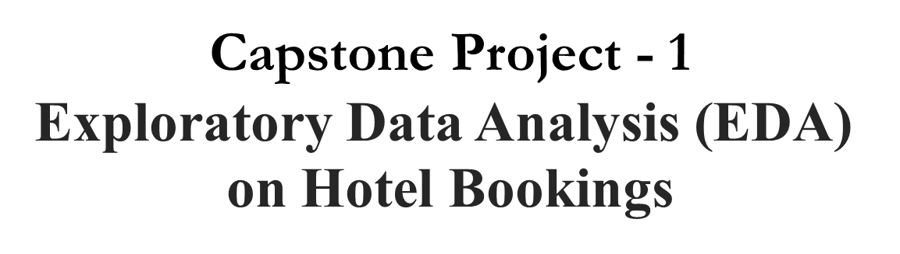

Sneha Owandkar

Slide 2

Content
About Dataset
Problem Statement
Data Understanding
Data Cleaning
Data validation and Publishing
Conclusion

Slide 3
Why Hotel Booking Analysis ?
Hospitality industry is big contributor to economic growth of any country
With a consistently growing middle class and increasing disposable income , tourism and hospitality sector witness healthy growth.
Our project we will be analyzing Hotel Booking data.
This data set contains information for a city hotel and a resort hotel , and includes information such as when the booking was made, length of stay ,the number of adults ,children and/or babies, and the number of available parking spaces.

Slide 4
Problem Statement :
The main objective behind this project is to explore and analyze data
To discover important factors that govern the bookings and give insights to hotel management , which can perform various campaigns to boost the business and performance.

Slide 5
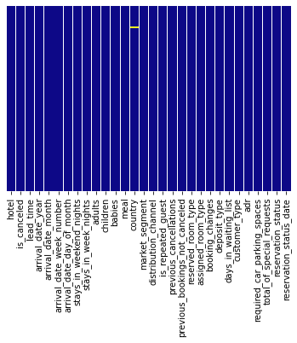
Data Understanding :
Libraries used: pandas, Numpy, Matplotlib,
seaborn, datetime
Total Bookings: 119390
Total Variables: 32

Slide 6

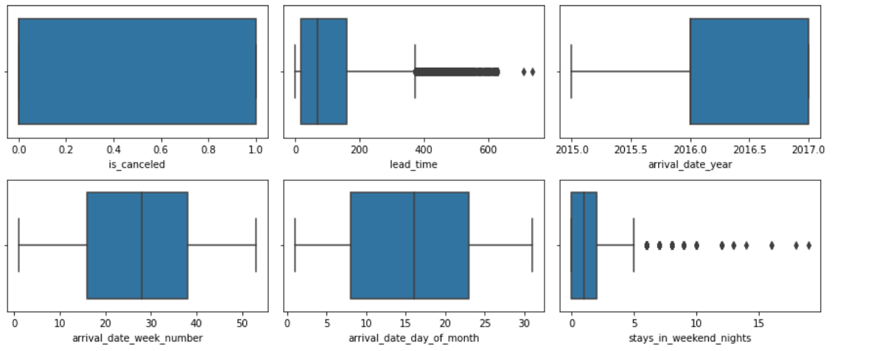
Data Cleaning :
Checked for Null values
Null values are presented in Variables such as children, country, agent and company.
Finding Percentage of null values
Addition and deletion of Null values
Converting to appropriate format
Finding outliers

Slide 7
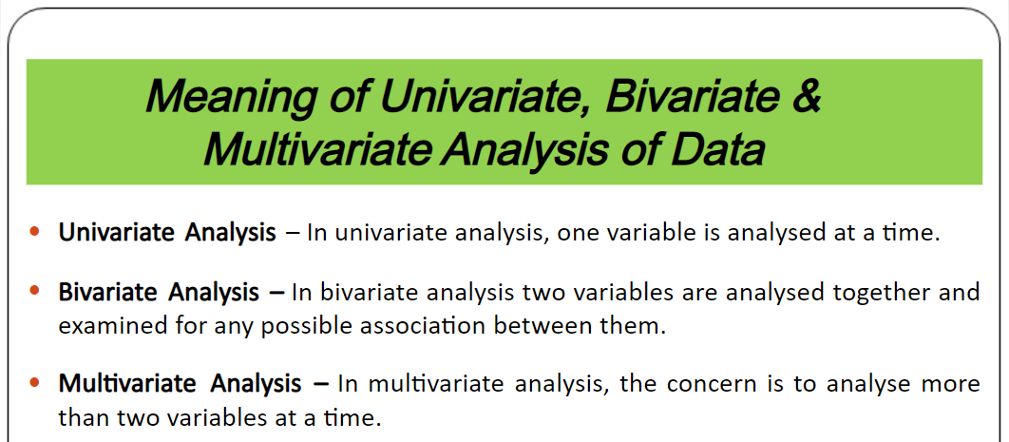
Data validation and Publishing

Slide 8
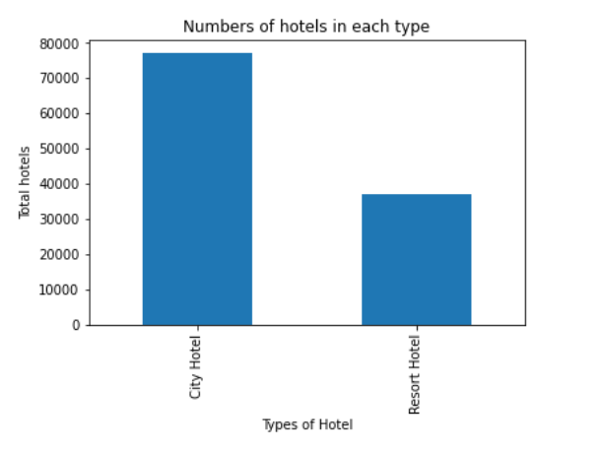
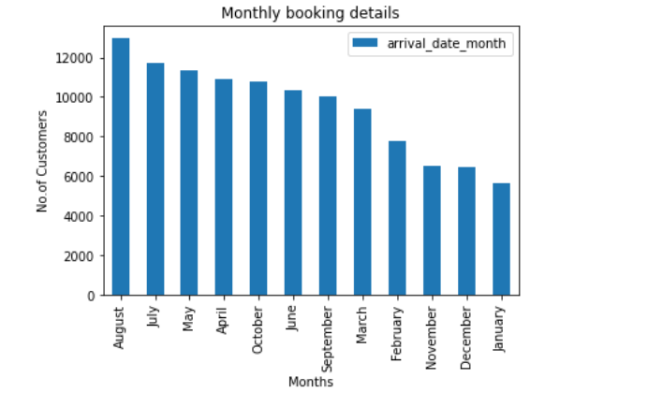
Number of Bookings in each Hotel type Number of Booking month-wise
Customer preferred City Hotel more than Resort Hotel
Bookings in August is highest
January found lowest numbers in booking counts.

Slide 9
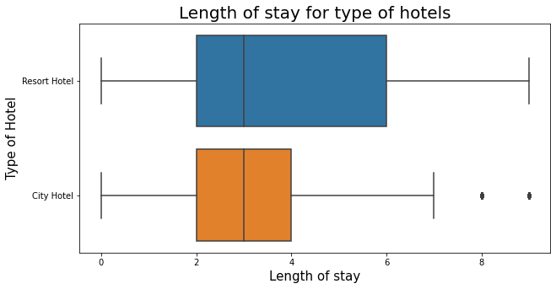
Length of stay in each hotel type Box plot
- If we ignore the outliers, the maximum length of stay is more in resort type as resort is mostly used for vacation purpose.
- Median of both the hotels are approximately equal.

Slide 10
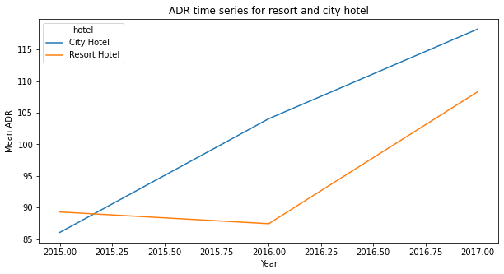
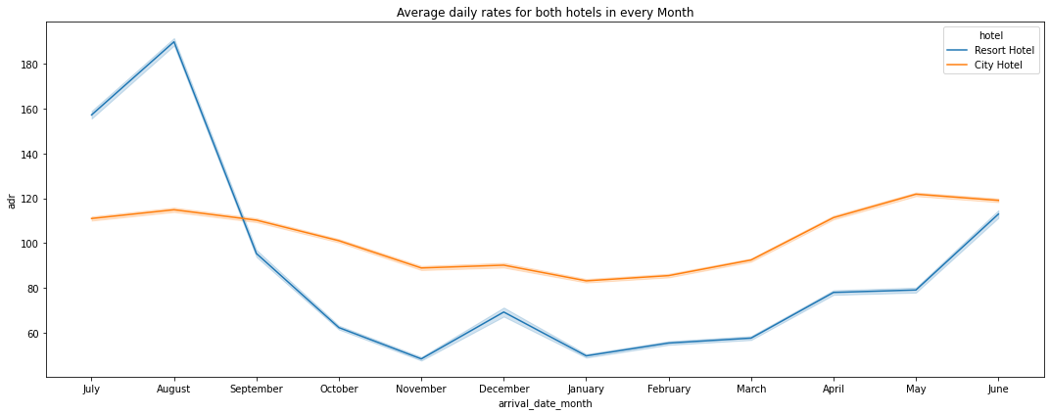
Average daily rates(adr) for each hotel type according to year
City hotels has always higher (adr) than resort hotel.
If the trend continues like that, resort hotel (adr) showing maximum increased inclination which means in few years resort hotel adr will cross the city hotel.
In the month of July and till the last week of August Resort hotels received more "adr" than City hotel
City hotel although dominating in 'adr' in remaining months of the year.

Slide 11
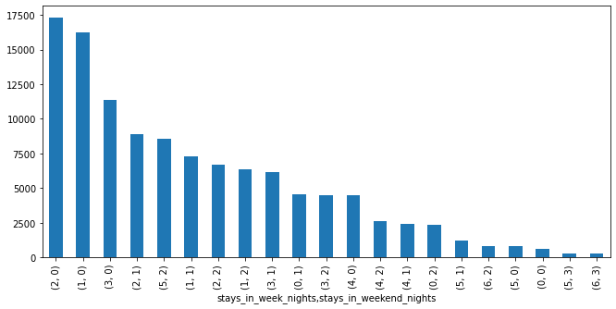
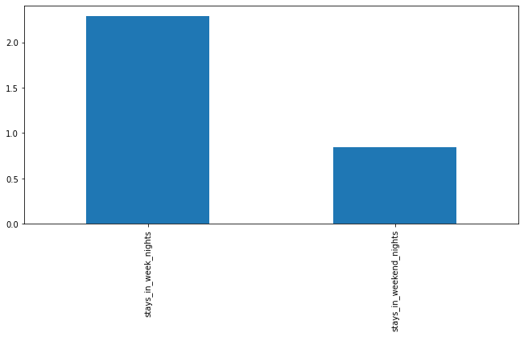
Stays in weekend and weekdays in hotels vs Bookings
Observation:
Maximum Booking done by customer for "2" weeknights stay and "0" weekend nights
On average, customers booking for 2-3 week-nights stay and 1 weekend-nights stay

Slide 12
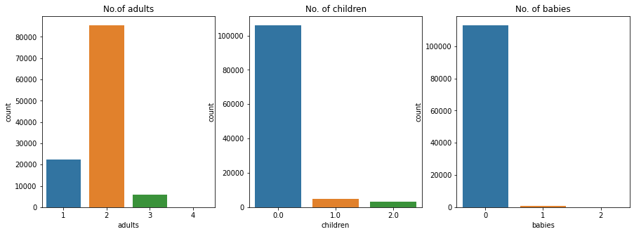
Count of adults , children ,babies in booking
Observation:
Bookings are mostly made for 2 adults with 1 children in combination

Slide 13
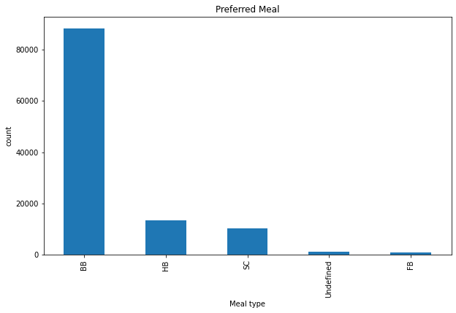
Preference of the meal by customer
Observation:
Customers of any type preferring "BB" Bed and breakfast type of meals.

Slide 14
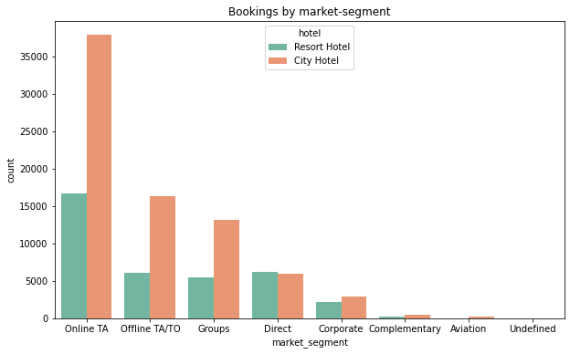
Booking by Market-segment
Observation:
Travel agency (TA) or Tour operator (TO) Plays vital role in Hotel booking
Except "Direct bookings", all market-segment has more number of bookings in city hotel type.

Slide 15
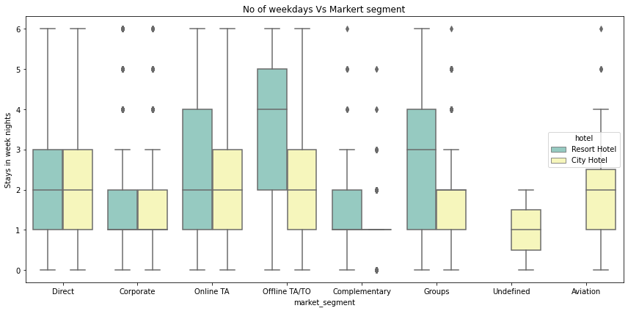
Number of Weekdays booked vs market segment
Observation:
Customer from direct market segment staying in same range numbers of week nights.
Offline TA/TO and Group market segment has some deviation over stays week-nights between Resort and City hotels
Undefined and Aviation market segment customer had not shown interest in the Resort Hotel

Slide 16
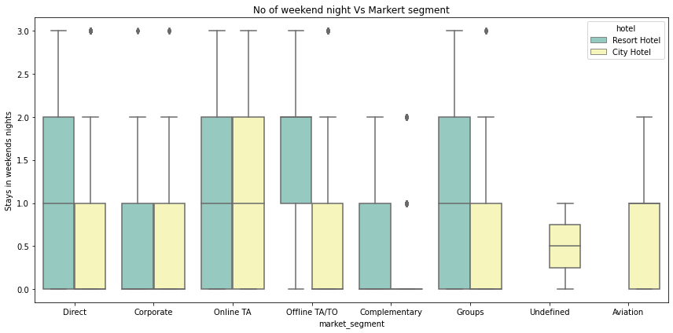
Number of Weekend nights booked vs market segment
Observation:
Direct market segment customer prefer to stay more weekend nights in the Resort Hotel type.
Online TA customer equally preferring between Resort and City hotels.

Slide 17
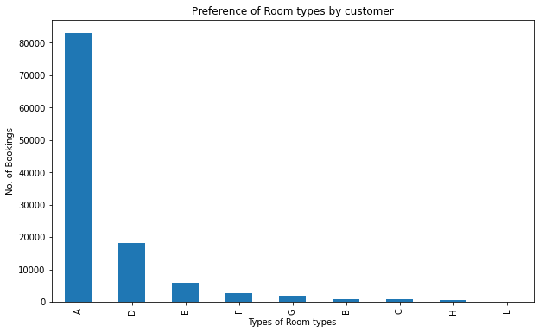
Preference of Room types by customer
Observation:
Room type of "A" preferred mostly by customers
Also it should be note the maximum numbers of booking done in the rooms type of A,D,E than others with minimum number of bookings

Slide 18
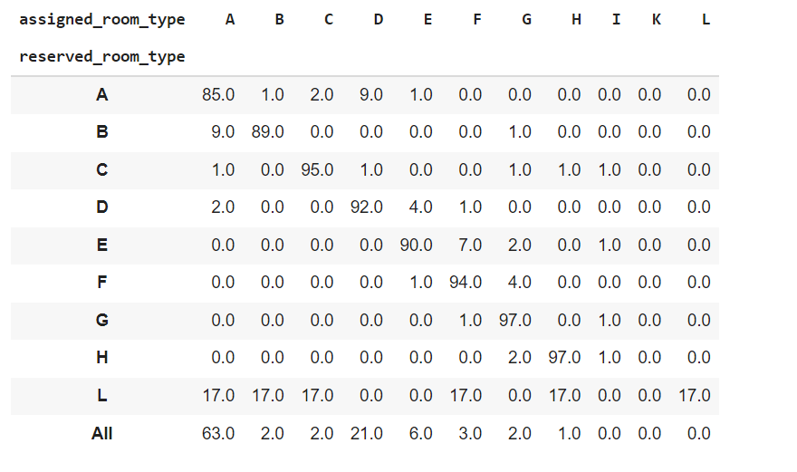
Rooms assigned to customer vs Rooms Reserved by the customer
Observation:
From crosstab, relationship of reserved and assigned rooms found.
Hotel ensured that, 97.0 % of Customer getting the same room type as reserved in room type "G" and "H"
Lowest possibility of getting the same room type when reserved in room type "L"
As we know, maximum number of booking done for room type "A" which ensured 85.0% of same room as reserved by the customer

Slide 19
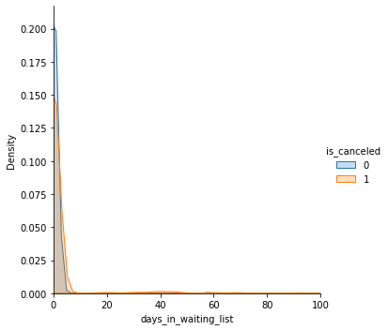
waiting time Vs cancellation
Observation:
As found from the density,
Increase in days in waiting list increasing the cancellation of the booking

Slide 20
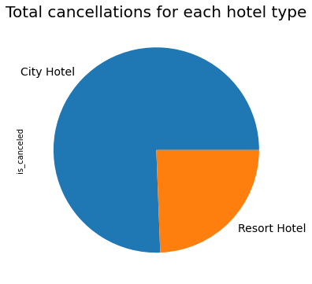
Total cancellations for each hotel type
Observation:
Percentage cancellation in city hotel is 41.09%.
Percentage cancellation in resort hotel is 27.66%

Slide 21
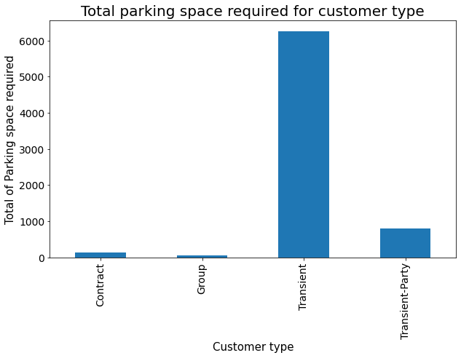
Sum of parking space needed according to type of booking
Observation:
When customer type is Transient that means the stay is more few days so it is possible that customer bringing his/her own vehicle that's why the parking space required it high for Transient
In contract and group booking customer will probably take a hired vehicle form hotel or from somewhere else that's why they do not need parking space.

Slide 22

Conclusion
Customer preferred City Hotel more than Resort Hotel
But, the maximum length of stay is higher (than city hotel) in resort type as resort is mostly used for vacation purpose.
Bookings in the month of August is highest and January found lowest number of bookings.
Bookings are mostly made for 2 adults with 1 children in combination
Customers of any type preferring "BB" Bed and breakfast type of meals
Greater number of bookings done by customer from country PRT(Portugal)
Travel agency (TA) or Tour operator (TO) Plays vital role in hotel booking
Except "Direct bookings", all market-segment has a greater number of bookings in city hotel type.

Slide 23
Room type of "A" preferred mostly by customers, which ensured only 85.0% of same room as reserved by the customer
Customer booking in the room type “G” and “H” getting 97.0% of the reserved room.
Undefined and Aviation market segment customer had not shown much interest in the Resort Hotel
When customer type is Transient that means the stay is more few days so it is possible that customer bringing his/her own vehicle that's why the parking space required it high for Transient
In contract and group booking customer will probably take a hired vehicle form hotel or from somewhere else that's why they do not need parking space.

